Slide 1
CEIS150 Module 2
Class Diagrams
Class Coding
Unit Testing

Slide 2
Rubric
Activity | Requirement(s) | Points
Class Diagram | Class Diagram | 10
Class Code | Screen Shot of Class Code | 15
Unit Test | Screen Shot of Unit Test | 15

Slide 3
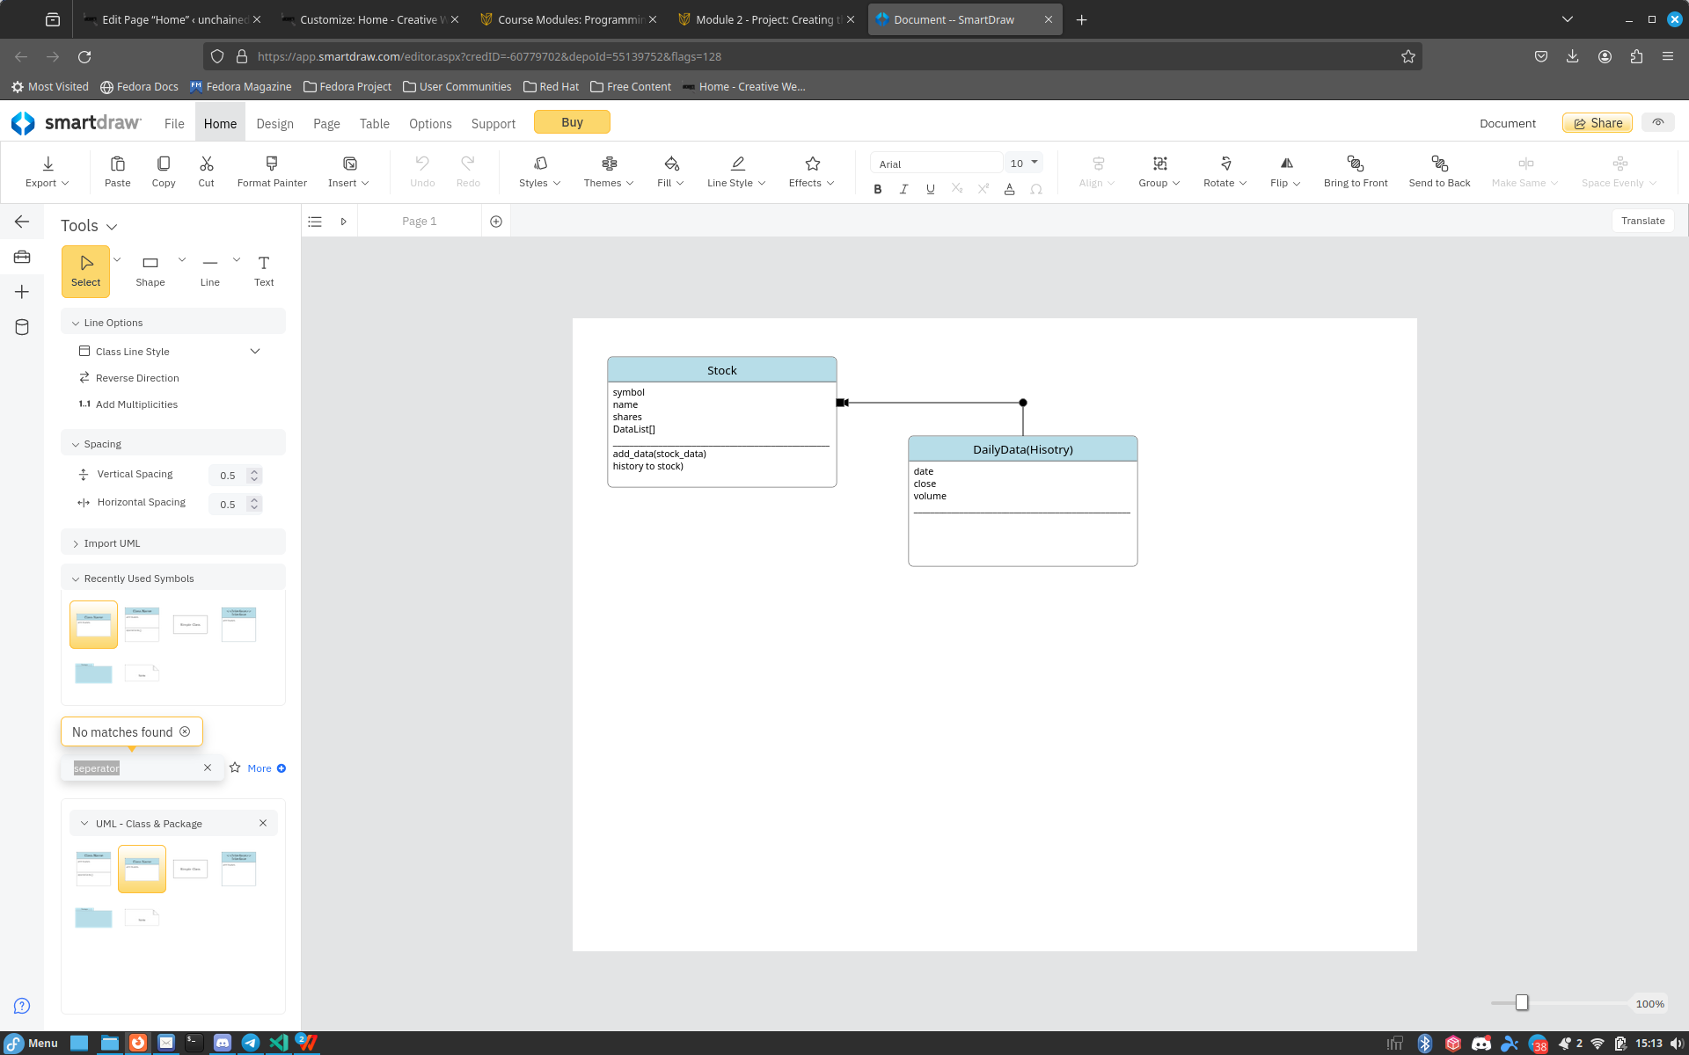
Class Diagram
Paste your Visio Class Diagram

Slide 4
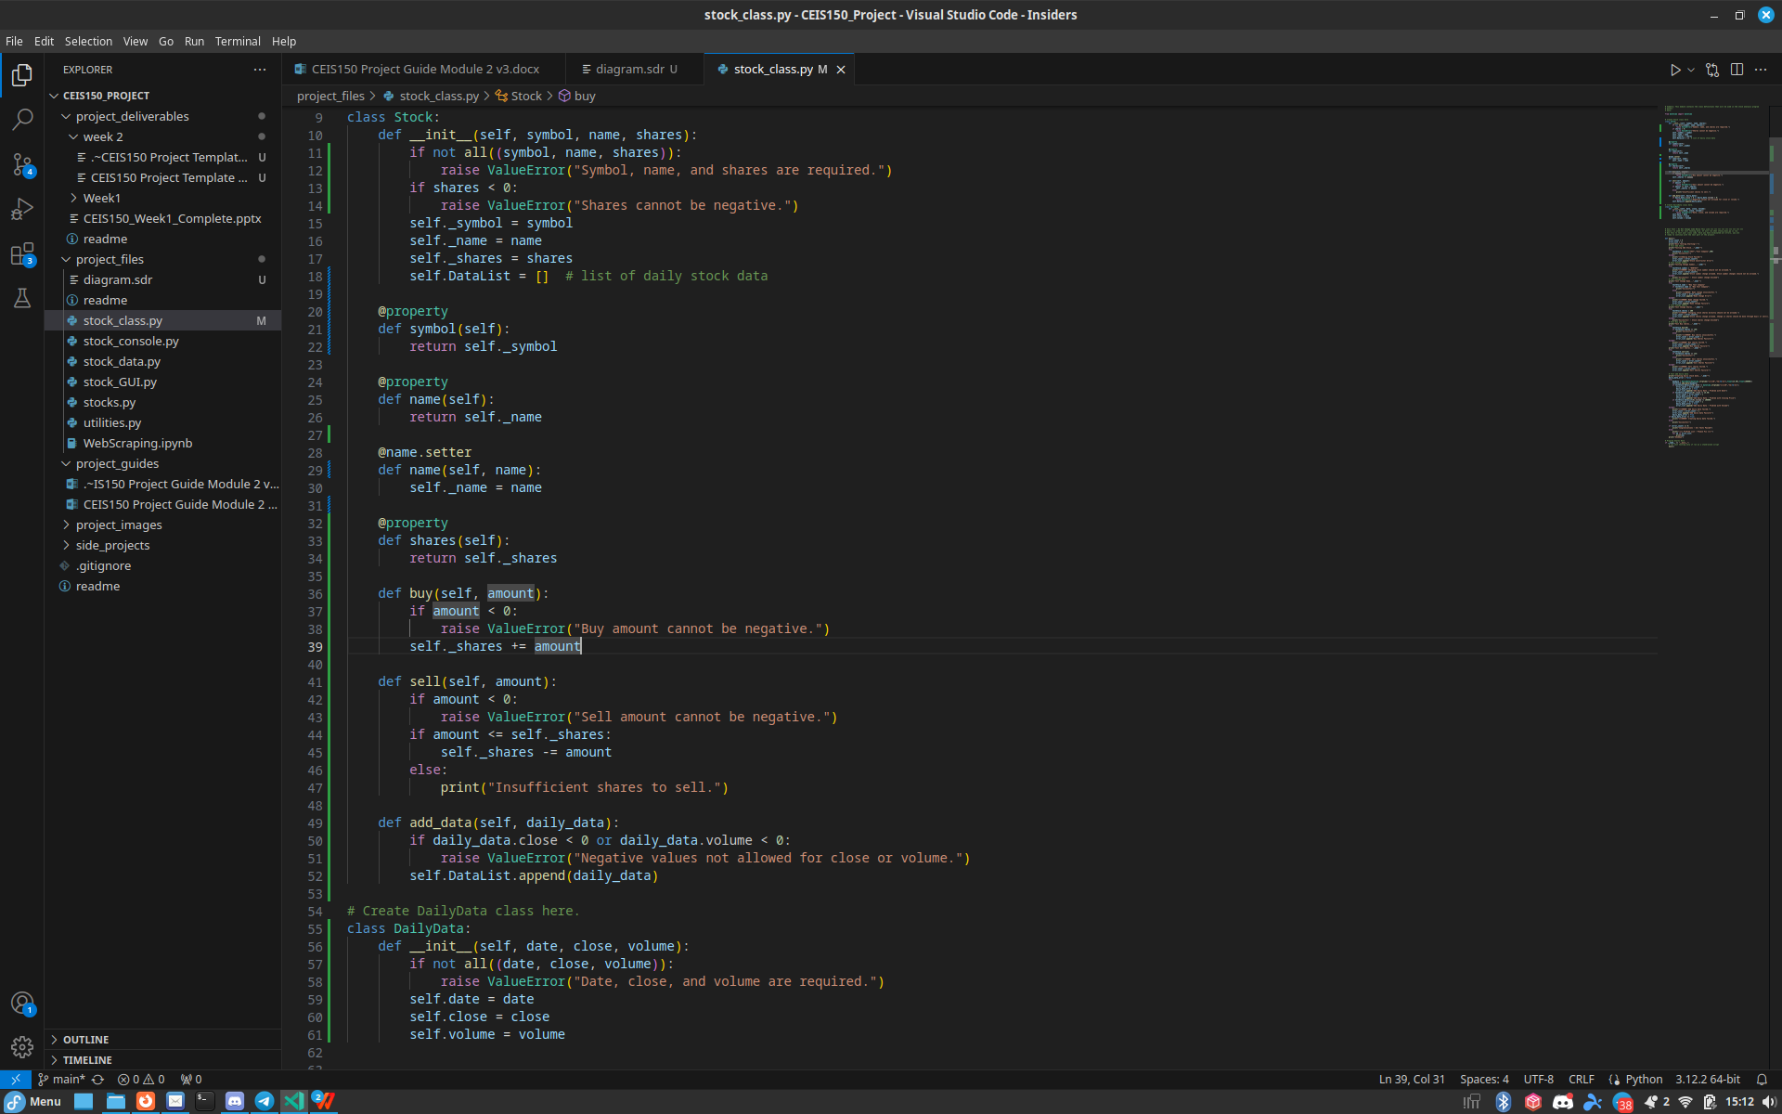
Class Code
Screen Shot of your stock_class.py file.
In my code I added raise ValueErrors
to ensure we had control over what
input was allowed. This ensures
the program does not allow negative
values on close,sell or buy as well as
volume and share.
It also displays an error for not
inputting Date,symbol and name.

Slide 5
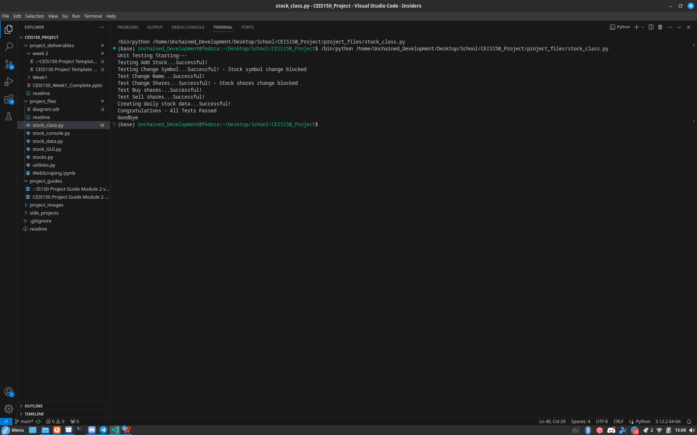
Unit Test
Screen Shot of your successful unit test.

